Slide 1
Very VBA
Day 4
The Data Boot Camp |
- 11/7/2017

Slide 2
Intro to Programming Logic

Slide 3
Ooh… Coding! (Sort Of)
Function
=
SUM(
1, 2, 3
)
Arguments
In a way, Excel has introduced you to a sort of proto-programming. Throughout your time writing scripts you will rely on functions (methods) that do something to or with arguments.

Slide 4
Conditionals: If This… Then That
Set Cell to True
If D2 > 5
Determine D2’s Value
If D2 <=5
Set Cell to False
=IF(D2>5,TRUE,FALSE)

Slide 5
How a Computer Thinks (Procedurally)
Complex Real-World Problem
Every problem in software development begins with a complex and abstract real-world need.

Slide 6
How a Computer Thinks (Procedurally)
Complex Real-World Problem
Step
Step
Step
Step
1
2
3
4
In order for a computer to handle things, this “real-world” problem needs to be broken into a set of procedural steps.

Slide 7
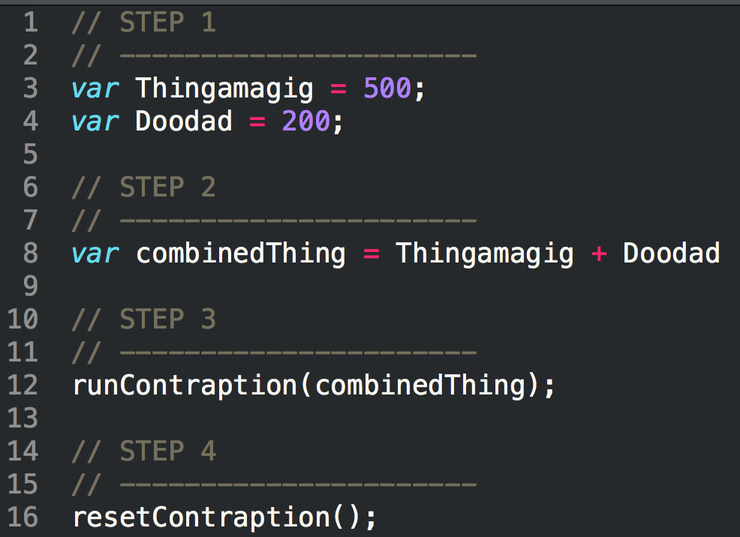
How Code is Written (Procedurally)
Code (JavaScript)
Steps
1
2
3
4

Slide 8
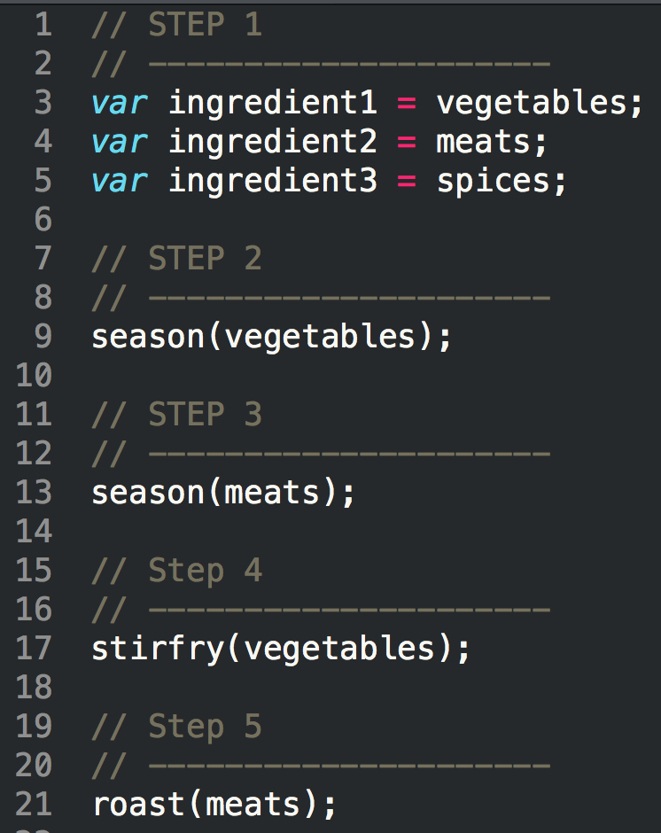
When Procedures Aren’t Enough…
Code (JavaScript)
Steps
1
2
3
4
5

Slide 9
Fundamental Building Blocks
Common structures in nearly all languages:
Variables / Arrays
Conditionals
Iterations
Functions

Slide 10
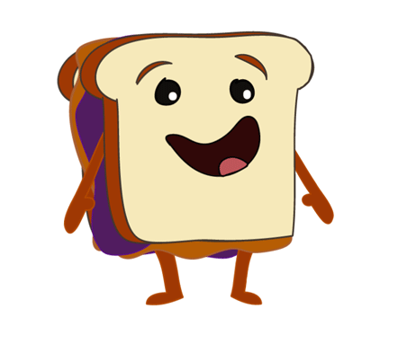
To Make A Sandwich…

Slide 11
To Make a Sandwich…
Logical Procedure
1. Get Bread, Peanut Butter, and Jelly from Pantry
2. Lay out bread on table.
3. Open canisters of Peanut Butter and Jelly.
Oh! I can’t wait to be eaten!
4. Get spreading knife.
5. Use spreading knife to smother peanut butter.
6. Use spreading knife to smother jelly.
7. Combine bread to create sandwich.

Slide 12
VBA Building Blocks

Slide 13
Variables / Arrays

Slide 14
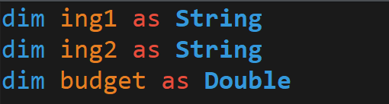
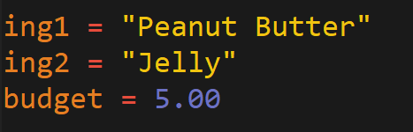
Variables: The Nouns of Code
Variables are effectively the items in a procedure.
They can be physical things (like an ingredient) or abstractions (like a counter).
In VBA, items can be declared as variables by using the dim followed by the type. They can then be assigned a value.
Variable Declaration
Variable Assignment

Slide 15
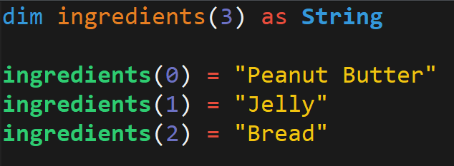
Arrays: A Collection of Items
Arrays are effectively groups of related items. It presents another way to store and reference like pieces of information.
[
Item: 0
Item: 1
Item: 2
[
Peanut Butter
,
Jelly
,
Bread

Slide 16
Conditionals

Slide 17
Conditionals: If This… Then That.
Conditionals present a way to control the flow of logic based on certain conditions being met.
In most languages, we’ll be using if / else code for this purpose.
Step
Step
If Condition a…
2a
1
If Condition b…
2b

Slide 18
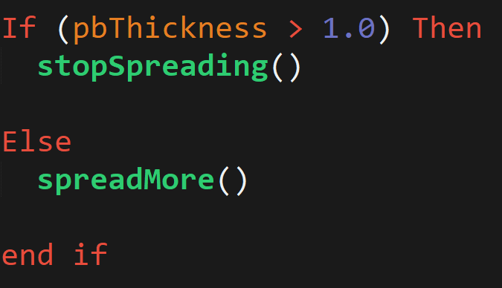
Conditionals: If This… Then That.
In VBA, conditionals are simply declared using the keywords If, Then, Elseif, Else, and End if.
Through VBA we can create far more sophisticated conditional logic than through Excel formulas alone.
Steps
1
2a
2b

Slide 19
Iteration (Looping)

Slide 20
Iteration: Round and Round We Go!
Iteration is the concept of using loops to perform a group of tasks repeatedly for a number of times.
In almost all languages, we’ll be using for-loops and while loops.
Step
1
2
Repeat X times…

Slide 21
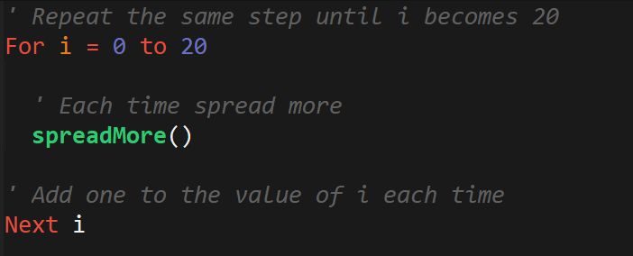
Iteration: Round and Round We Go!
This code will make more sense later… but basically it’s the VBA way of repeating the same block multiple times.
2

Slide 22
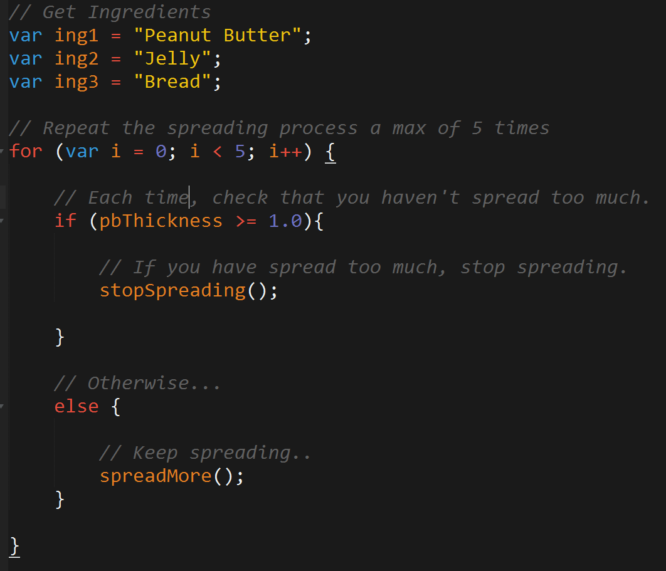
Build the Program!
Steps
1
2
3a
3b

Slide 23
Functions

Slide 24
Functions: For When One Block Can’t Do it All
Functions are, in essence, a sort of “sub-processes”. They allow us to create pre-made, re-usable blocks of code which can be called on demand.
Main Process
1
2
3
4
1
2
3
1
2
3
3
Sub-Processes

Slide 25
Putting It All Together…

Slide 26
To Make a Sandwich…
Logical Procedure
1. Get Bread, Peanut Butter, and Jelly from Pantry
2. Lay out bread on table.
3. Open canisters of Peanut Butter and Jelly.
Oh! I can’t wait to be eaten!
4. Get spreading knife.
5. Use spreading knife to smother peanut butter.
6. Use spreading knife to smother jelly.
7. Combine bread to create sandwich.

Slide 27
To Make a Sandwich…
Logical Procedure
1. Get Bread, Peanut Butter, and Jelly from Pantry
2. Lay out bread on table.
3. Open canisters of Peanut Butter and Jelly.
Oh! I can’t wait to be eaten!
4. Get spreading knife.
5. Use spreading knife to smother peanut butter.
6. Use spreading knife to smother jelly.
7. Combine bread to create sandwich.

Slide 28
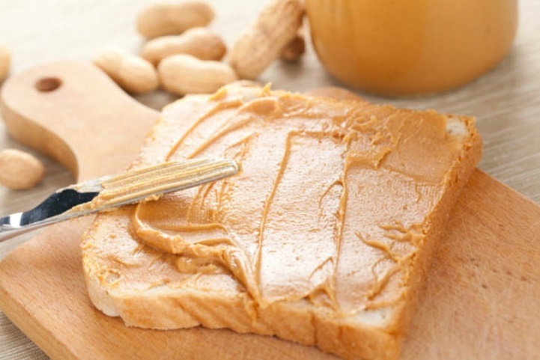
To Make a Sandwich (Full Logic)…
Get Items
Repeatedly “spread the Peanut Butter”
Check if thickness condition met.
3a. If thickness condition is met run stop function.
3b. If thickness condition is not met then spread more.
Steps
1
2
1
3a
3b
1
2
2

Slide 29
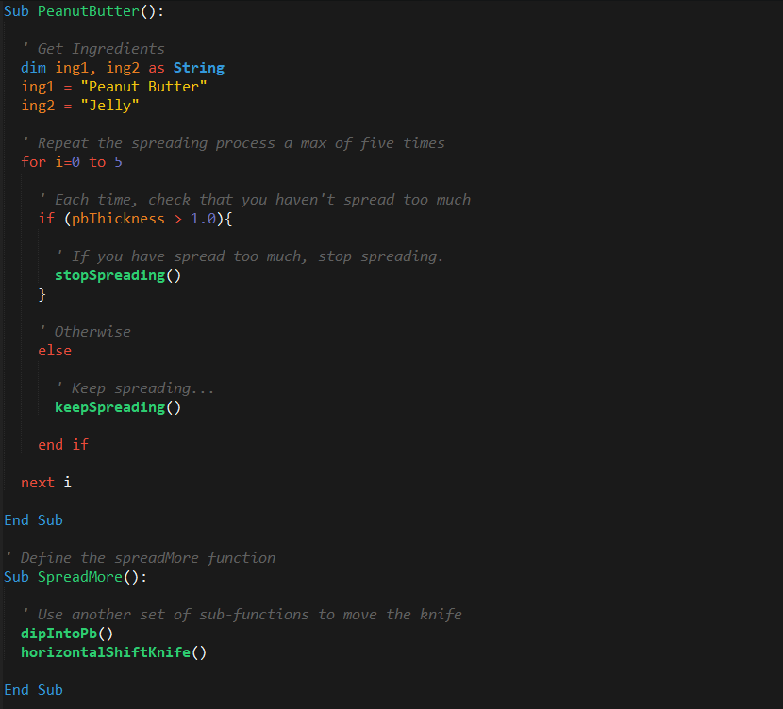
To Make a Sandwich (In Code)…
Steps
1
2
1
3a
3b
1
2
2

Slide 30

Big Picture!
Coding = Building Blocks and Putting them Together

Slide 31
Let’s Get Coding!

Slide 32
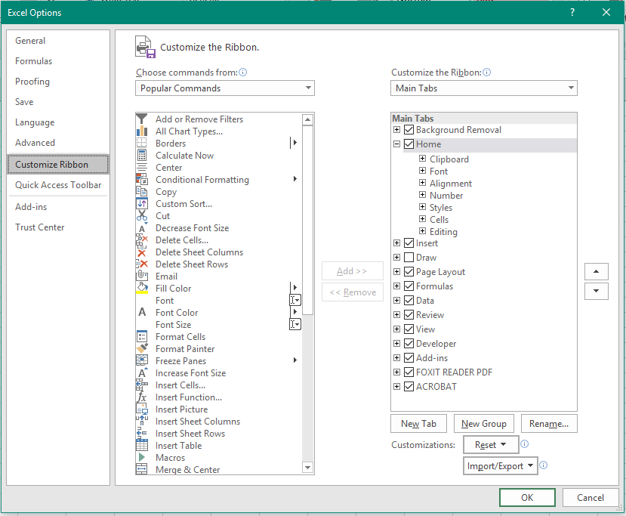
But First… Let’s Add Developer Tools!
On a Windows machine, visit File -> Excel Options.
Then navigate to Customize Ribbon to enable the Developer tab.

Slide 33
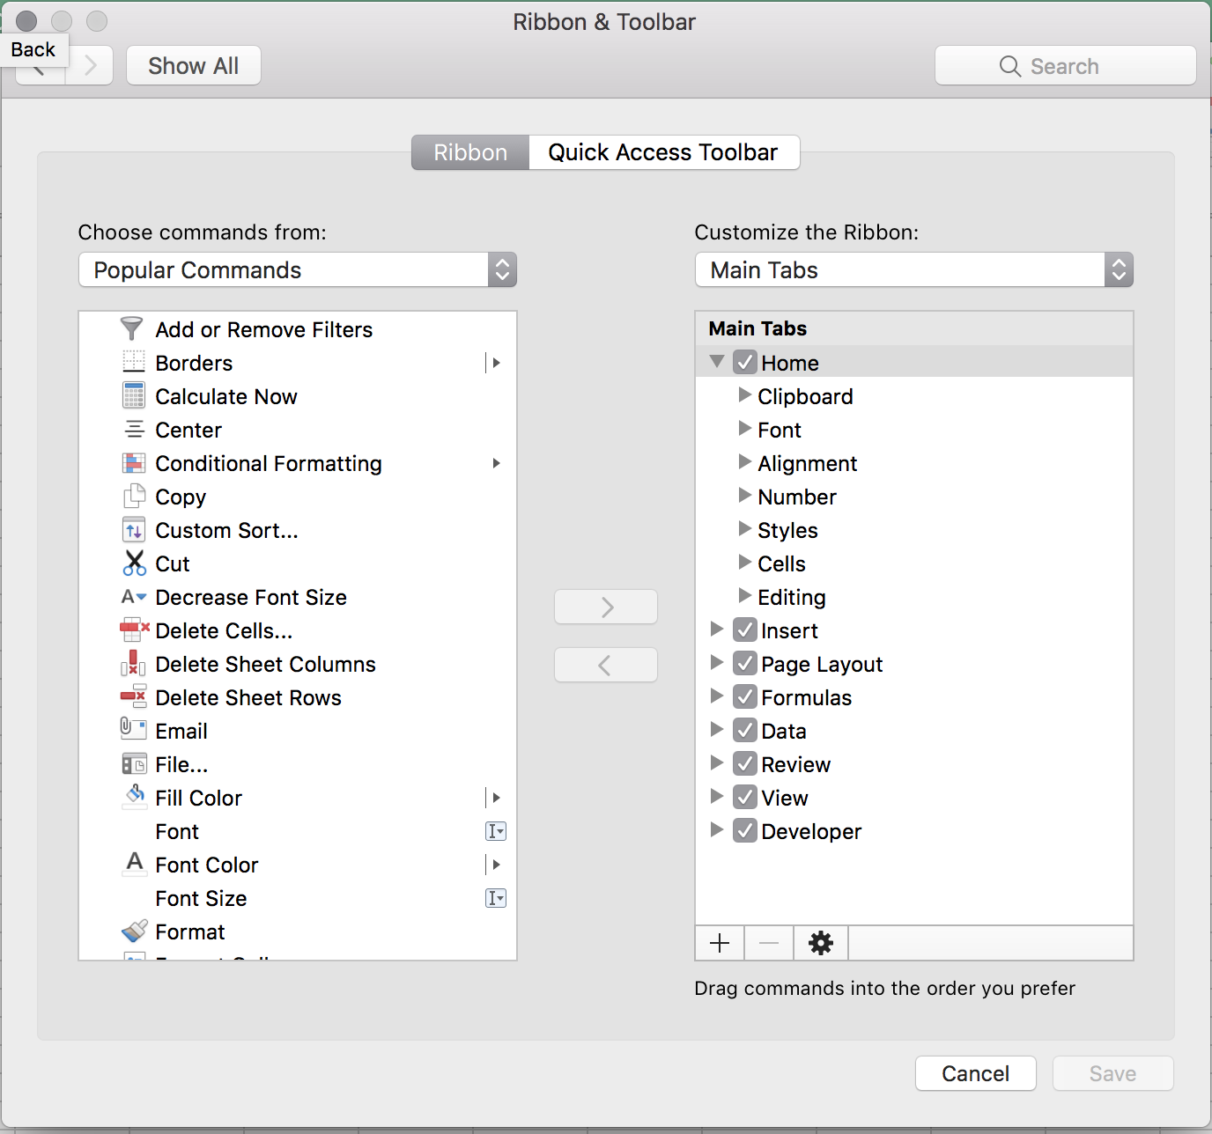
But First… Let’s Add Developer Tools!
On a Mac machine, visit Excel -> Preferences.
Then navigate to Ribbon and Toolbar to enable the Developer tab.

Slide 34
Questions / Discussion
Notes:
It’s important to keep in mind why you joined this class. Let’s talk about your goals.

